Slide 1
Cloud Computing
Cloud Computing is model for enabling network users on demand access to share pool of configurable computing resources that can be rapidly provisioned and release to the clients without direct service provider interaction.
Cloud Computing is a general term used to describe a new class of network based computing that takes place over the Internet- Using different resources such as servers, storage, databases, software and applications are provided as a service to users on-demand. Users can access these resources an a pay-as-you-utilized them.
A collection / group of integrated and networked hardware, software and Internet infrastructure-Platform. Using the Internet for communication and transport provides hardware, software and networking services to clients.
These platforms hide the complexity and details of the underlying infrastructure from users and applications by providing very simple graphical interface or Applications Programming Interface.

Slide 2
Cloud Computing
Characteristics :
On-demand self-service, Scalability, Flexibility
Broad network access, Reliability
Resource pooling, Security, Collaboration
Rapid elasticity, Automation, Real-time analytics
Measured service, Compliance and Governance
Multi-tenancy, High performance Computing
Applications :
Data Storage and Management
Web and Mobile applications
Big data analytics
Internet of Things
Artificial Intelligence and Machine learning
Online Education and learning platforms
Social media and collaboration tools
Gaming and virtual reality
Cyber security and threat intelligence
CRM, SCM, FM and Accounting, Health care and Medical Research

Slide 3
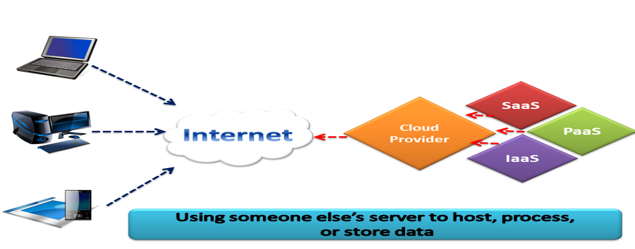
Cloud Computing

Slide 4
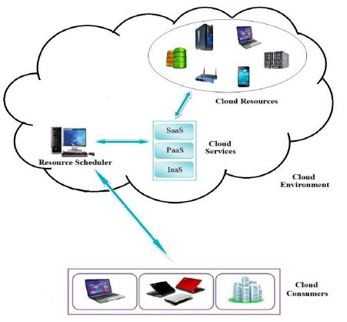
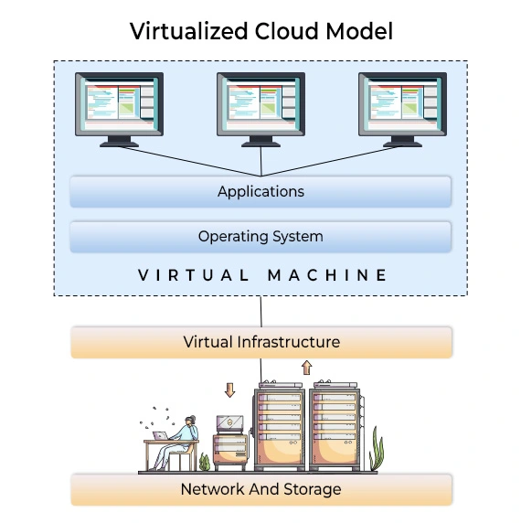
Cloud -Essentials
Abstraction:
Cloud computing abstracts the details of system implementation from users and developers.
Applications run on physical systems that aren’t specified, data is stored in locations that are unknown, administration of systems is outsourced to others, and access by users is ubiquitous.
Virtualization:
Cloud computing virtualizes systems by pooling and sharing resources.
Systems and storage can be provisioned as needed from a centralized infrastructure, costs are assessed on a metered basis, multi-tenancy is enabled, and resources are scalable with agility.

Slide 5
Cloud -Essentials
To help clarify how cloud computing has changed the nature of commercial system deployment,
consider these three examples:
Google:
Google has built a worldwide network of datacenters to service its search engine. In doing so Google has captured a substantial portion of the world’s advertising revenue.
That revenue has enabled Google to offer free software to users based on that infrastructure and has changed the market for user-facing software.
Azure Platform:
Microsoft is creating the Azure Platform. It enables .NET Framework applications to run over the Internet as an alternate platform for Microsoft developer software running on desktops.
Amazon Web Services:
One of the most successful cloud-based businesses is Amazon Web Services, which is an Infrastructure as a Service offering that lets you rent virtual computers on Amazon’s own infrastructure.

Slide 6
Cloud Computing
Cloud computing is the result of evolution and adoption of existing technologies and paradigms: Autonomic computing, Client–Server model, Grid computing, Mainframe computer, Utility computing, Peer-to-peer and Virtualization.
Goal of Cloud Computing: To allow users to take maximum benefits from all of these technologies, without the need for deep knowledge about or expertise with each one of them.
To reduced costs, and help the users focus on their core business instead of being restricted by IT obstacles.
Service Models : Saas, Paas, Iaas, Caas, Naas.
Deployment models:
Private cloud : Enterprise owned or lease
Public cloud : Sold to the public, mega-scale infrastructure
Hybrid cloud : Composition of two or more clouds
Community cloud : Shared infrastructure for specific community

Slide 7
Cloud Computing
SaaS: (Software as a Service)
Google Apps, Microsoft Office 365, Google, AWS, ORACLE, SAP, Zoom
PaaS: (Platform as a Service)
Google App Engine, Salesforce- Heroku, Openshift-RedHat, AWS Elastic Beanstalk, Amazon Web Services(AWS)
IaaS:(Infrastructure as a Service)
Amazon EC2, Google computer engine, HP Cloud, Oracle infrastructure, Rackspace Open Cloud, Relia Cloud, IBM Cloud, Vmware cloud an AWS, Microsoft Azure, Digital Ocean
Caas: (Container as a Service)
Google Kubernetes, Docker Swarm, AWS Elastic Container Service(ECS), Google cloud Container, Azure Container Instances (ACI)
NaaS : (Network as a Service)- SDN, NFV, Cloud Networking, WAN Optimization, Security as a service(SECaaS)- Use cases
AWS network services, Google, Microsoft Azure, CISCO Cloud, VM ware NSX cloud.

Slide 8
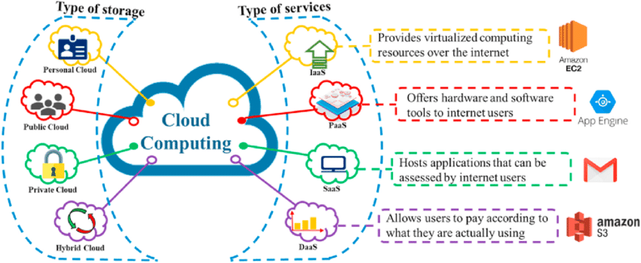
Cloud Computing

Slide 9
Cloud Computing-Benefits
Environmental Friendly
Software Integration
Cost Proficient
More secure
Greater Flexibility
Infinite storage
Rapid Development
Backup and Recovery
Document Control
Fewer maintaince issues

Slide 10
Cloud Computing-Limitations
Doesn’t work well in low speed connections
Outsourcing data storage increases potential for attacker
Supplier stability
Accessibility
Security of stored data
Enable piracy and Copyright infringement
Requires constant Internet connections
Unreliable services due to due to inadequate ICT or Power Infrastructure
Risk of Vendor Locking

Slide 11
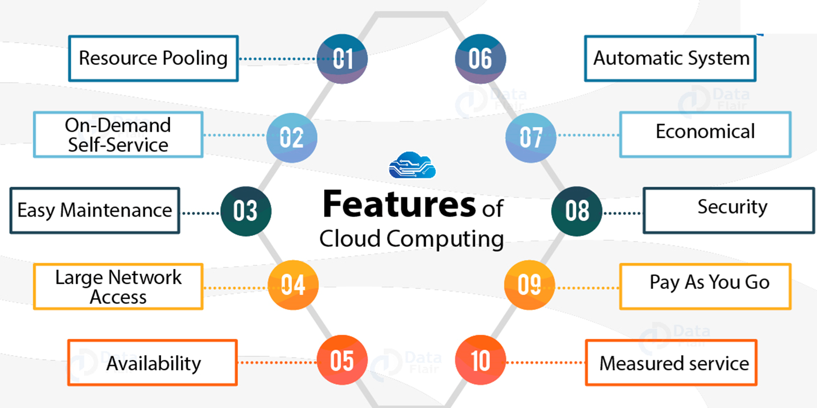
Cloud Computing-Features

Slide 12
Cloud Computing-Challenges
Percentage | Cloud Usage / Issues
97% | Many organizations uses cloud services- Public, Private, Hybrid
65% | Cloud strategy aspects
10% | Anticipate decrease in cloud investment
53% | Unauthorized access
44% | Hijacking of accounts
49% | Insecure Interfaces or APIs
33% | External Sharing of data

